Slide 1
5.2 - Moving Optics
Velocity selector
Disk Chopper
Fermi Chopper

Slide 2
Velocity Selectors
-
Select the neutron energy you want

Slide 3
VELOCITY SELECTORS
absorbing blades

Slide 4
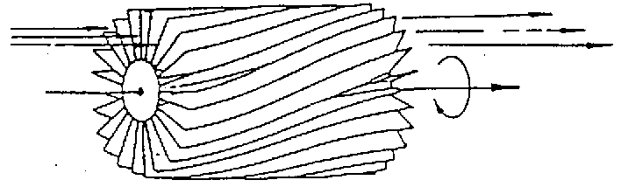
VELOCITY SELECTORS

Slide 5
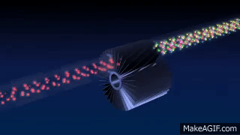
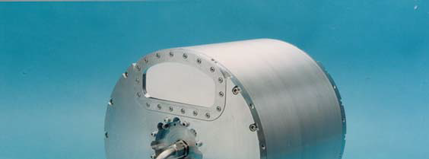
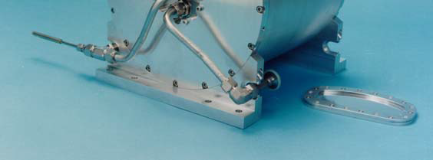
VELOCITY SELECTORS
‘broad’ monochromatization δλ/λ ≈ 10 %
ILL.FR
Astrium

Slide 6
VELOCITY SELECTORS
INPUT PARAMETER
xwidth [m] width entry aperture
yheight [m] height entry aperture
zdepth [m] housing! length
length [m] blade length
d [m] blade thickness
alpha [deg] twisting angle
radius [m] distance rotation axis – aperture centre
nu [Hz] rotation speed, counterclockwise
nslit [] number of blades
housing

Slide 7
DISK CHOPPER
Define time structure of the beam
Time Of Flight (TOF) measurements

Slide 8
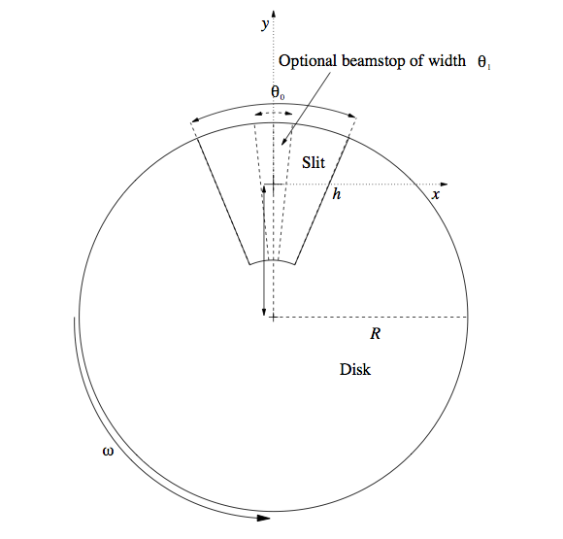
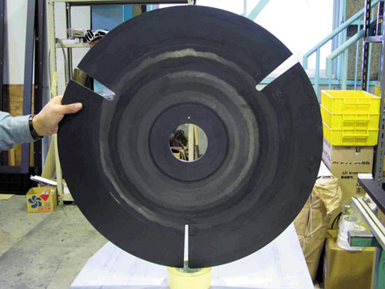
DISK CHOPPER

Slide 9
DISK CHOPPER
INPUT PARAMETER
nu [Hz] frequency
yheight [m] slit height (if 0, yheight = radius)
radius [m] disk radius
theta_0 [deg] angular width of slits
xwidth [m] horizontal slit width opening, beam center
jitter [s] jitter in time phase
delay [s] time delay
phase [deg] angular delay, overrides time
Isfirst [0/1] several choppers, defines first chopper
npulse [1] number of pulses if isfirst=true
verbose [1] display disk chopper config

Slide 10
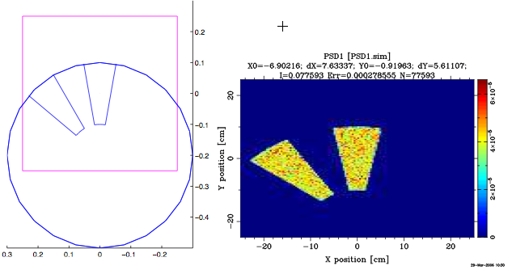
DISK CHOPPER_S

Slide 11
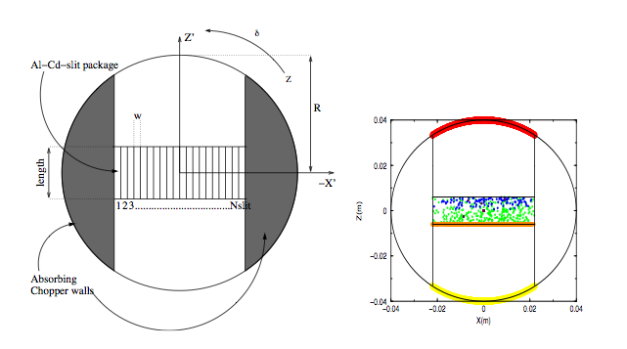
FERMI CHOPPER

Slide 12
DISK CHOPPER
Exercise
Open the Ex_4_2_DiskChopper.instr instrument
Notice use of the EXTEND %{ %} section, defining a time structure (1 second, flat distribution)
Notice use of Monitor_nD, our “Swiss army knife” monitor
options=”t auto bins=200”
options="t auto bins=200 x auto bins=200"

Slide 13
DISK CHOPPER
Exercice :
Insert a disk chopper 0.5 mm after guide exit
Chopper Component Parameters:
- radius of disk-chopper (we use 0.5 m)
- n, number of openings (we use 2)
- Phase (angular phase at t=0, in degrees, we use 90 deg)
Instrument input parameters:
f (Hz) - chopper frequency
Theta0 (degrees) - opening width of slits

Slide 14
DISK CHOPPER
Exercise
Make a TRACE to get an overview of the instrument
SIMULATE 1e7 neutrons at the default of f=5Hz and Theta0=10 degrees. While simulation is ongoing, estimate the number of pulses per second?
Try another 1e7 at f=1 hz. Notice space-time correlation in the third TOF panel
At a given frequency, try changing the Theta0 chopper opening to higher and lower value. Comment on the results.

Slide 18
Hints / results
- From the hint (de Broglie)

